Slide 1
CAMERA DATASET

Slide 2
This is a dataset of 1000 cameras.
It contains the features and other characteristics of the cameras.
The dataset shows the growth of cameras across years.
It shows how the camera has been developed over the years.
As we know today, photography is one of the best adventurous and passionate career one can pursue, so cameras has its own values for succeeding in photography.
Even for a ordinary person camera has its own importance as it helps to capture the best or happy moments in our life.
So this dataset helps us to compare cameras with respect to price or features or other charateristics, and chose the most suitable for you.

Slide 3
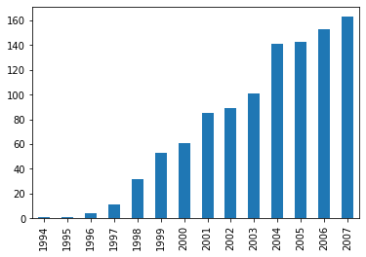
1 No of models released over years The below graph shows that there is a steady increase in the no of models released based on years.

Slide 4
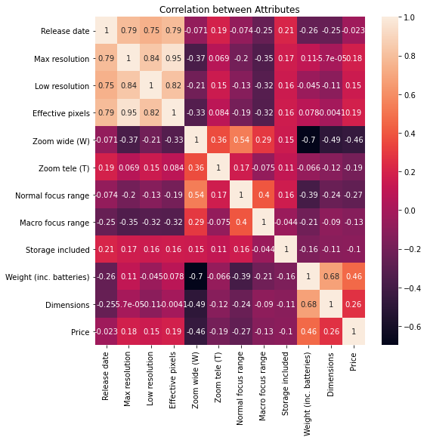
2 Find the correlation between the attributes The below figure shows the correlation of the attributes

Slide 5
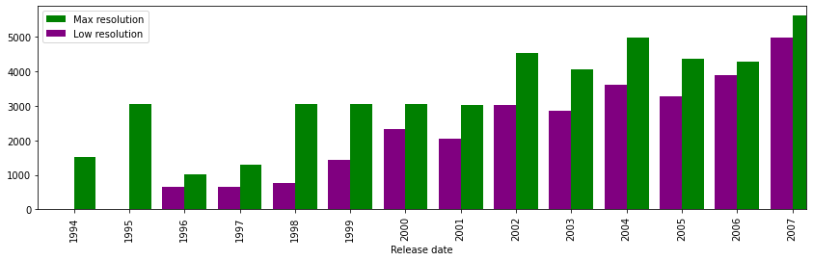
3 Growth of resolutions over the years We can see that resolutions are enhanced at every year

Slide 6
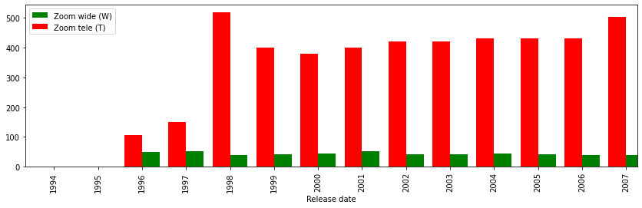
4 Growth of zoom over the years the enhance in both type of Zoom (wide and tele) are increase in slow manner

Slide 7
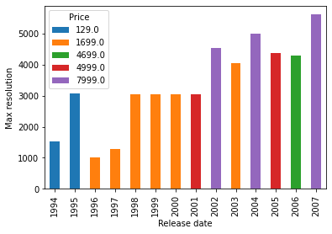
5 Relationship between max resolution and prices over the years This show relaship between price and Max resolution on all years

Slide 8
THANK YOU

